Slide 1
Analysis of Interest rates(IR) USD and CAD LIBOR data
Aloagbaye Momodu
Lantern Institute
Statistics with R
with
Dr. Dmitri Vyushin

Slide 2
Overview
Data collection
Time series analysis
PCA Analysis
Vasicek modelling

Slide 3
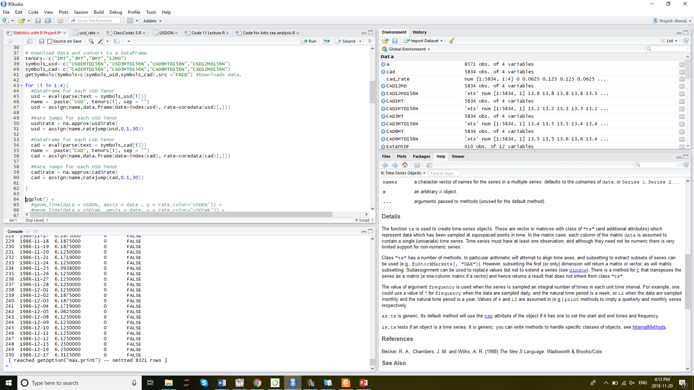
Data Collection

Slide 4
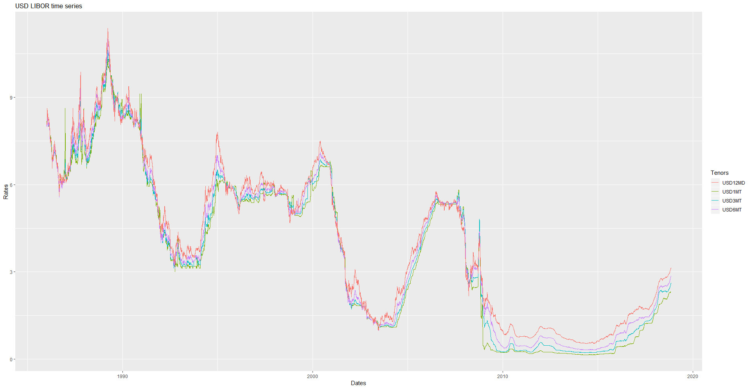
USD LIBOR TIME SERIES

Slide 5
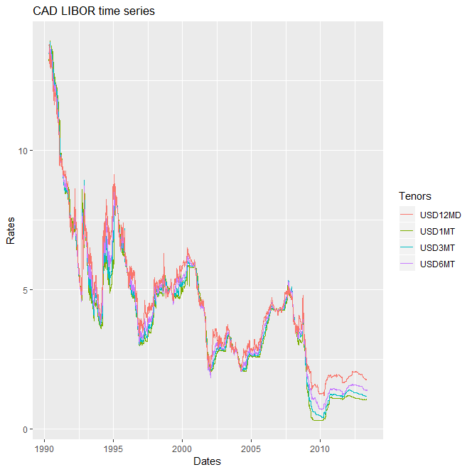
CAD LIBOR TIME SERIES

Slide 6
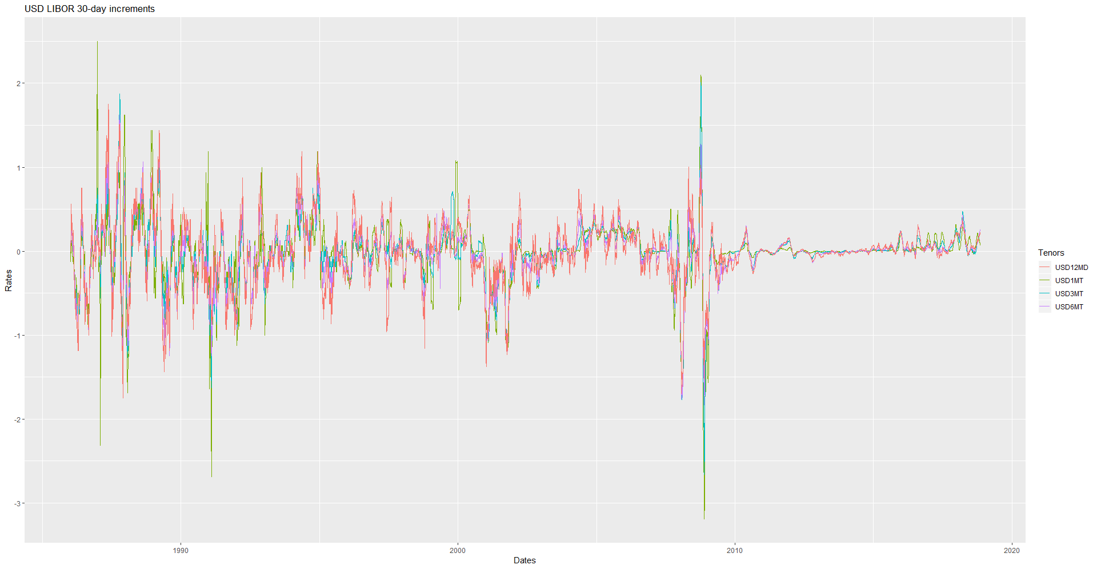
USD 30-DAY INCREMENT

Slide 7
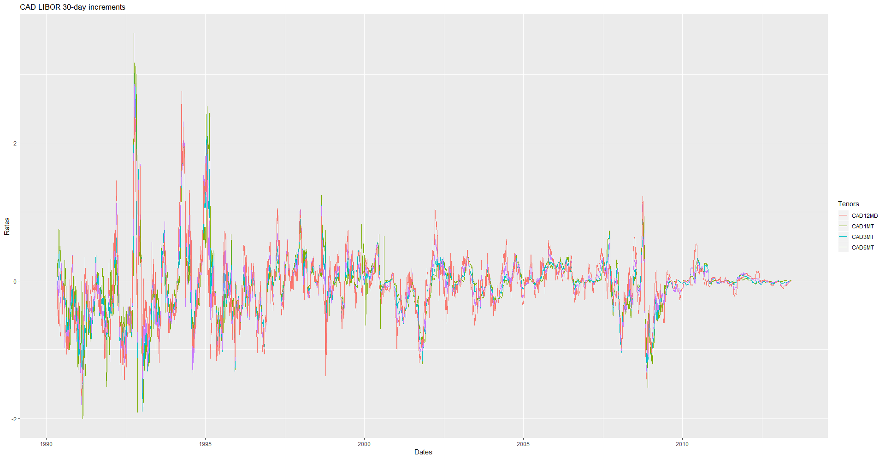
CAD 30-DAY INCREMENT

Slide 8


Observations
Huge jumps just before 1994 from the 1-DAY increment.
Huge jumps in the 2008 global recession from the 30-DAY increment.
Dickey fuller test: p-value
0.6416 (IR)
0.01 (increments)

Slide 9
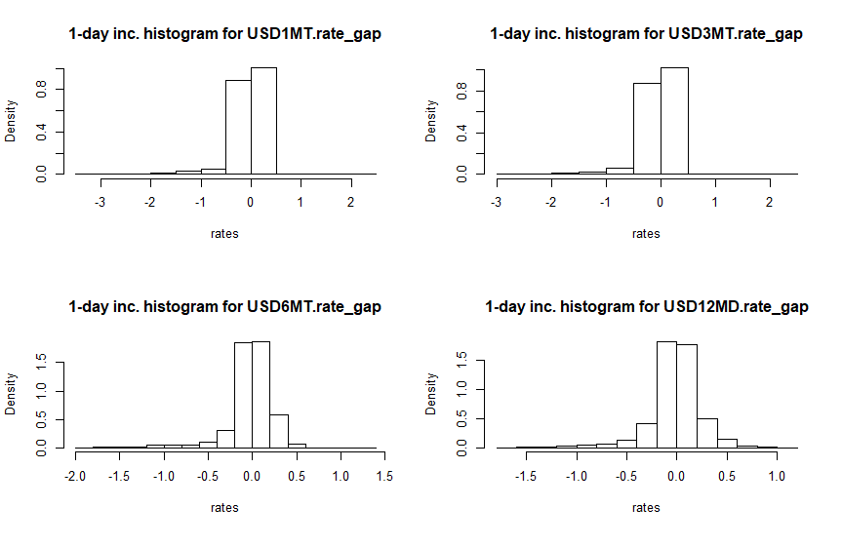
DISTRIBUTION FITTING
Normal distribution with small tails, low skewness and high kurtosis?

Slide 10
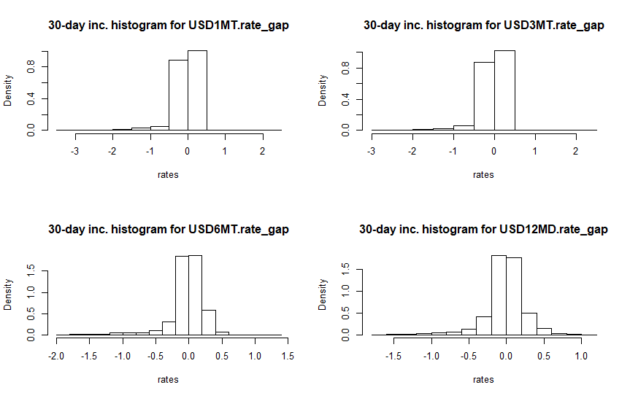
DISTRIBUTION FITTING

Slide 11
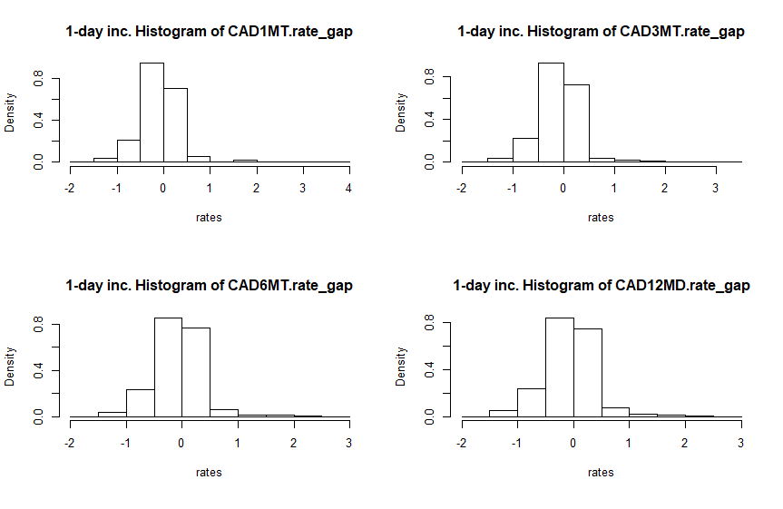
DISTRIBUTION FITTING

Slide 12
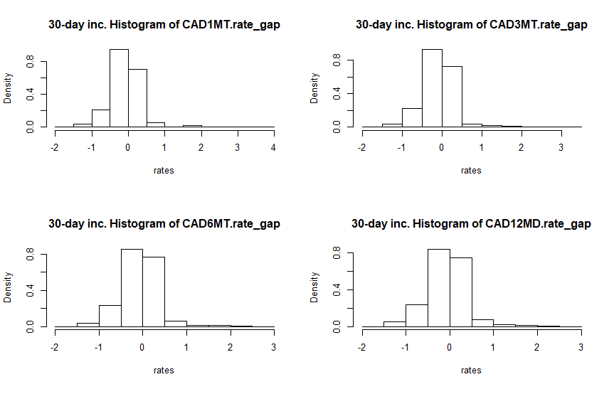
DISTRIBUTION FITTING

Slide 13
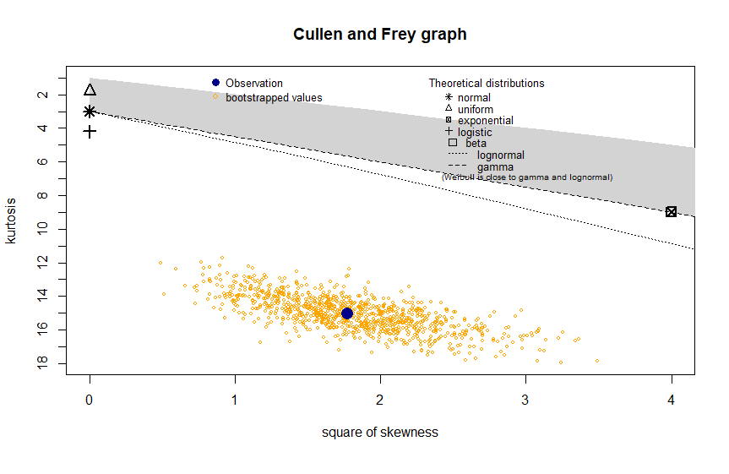
DISTRIBUTION FITTING

Slide 14
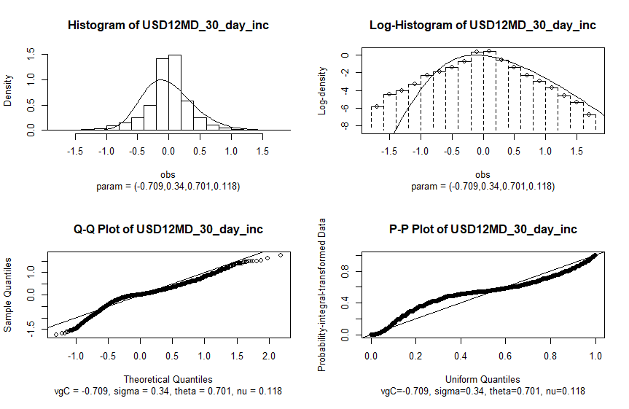
DISTRIBUTION FITTING

Slide 15
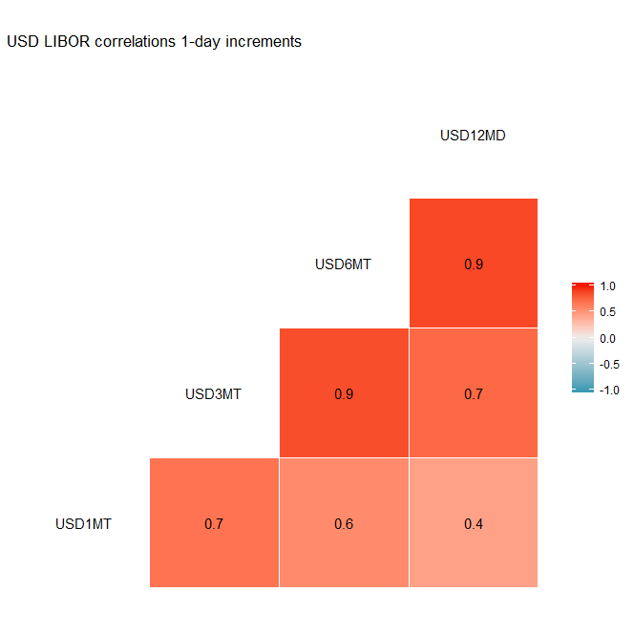
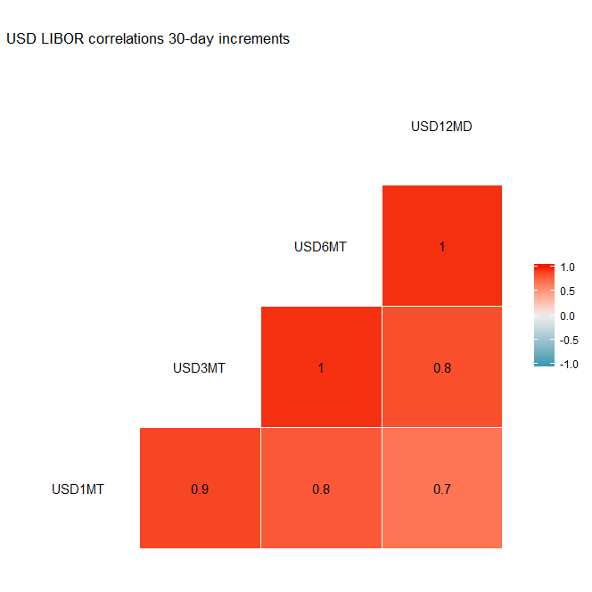
USD TENOR CORRELATIONS
Higher correlations on the 30-DAY increment
Lesser correlation between short term and long-term rates
Highest correlation =1 between the 3MT,6MT and 12MD 30-DAY increment.
Lowest correlation =0.4 between the 1MT AND 12MD 1-day increment.

Slide 16

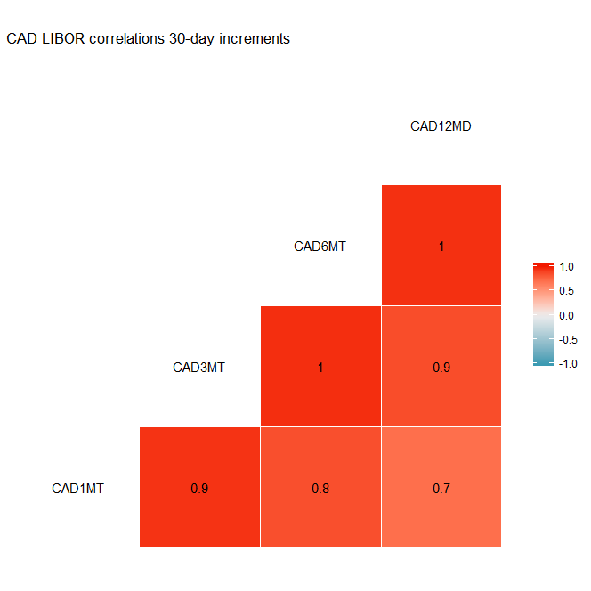
CAD TENOR CORRELATIONS
Higher correlations on the 30-DAY increment
Lesser correlation between short term and long-term rates
Highest correlation =1 between the 3MT,6MT and 12MD 30-DAY increment.
Lowest correlation =0.6 between the 1MT AND 12MD 1-day increment.

Slide 17
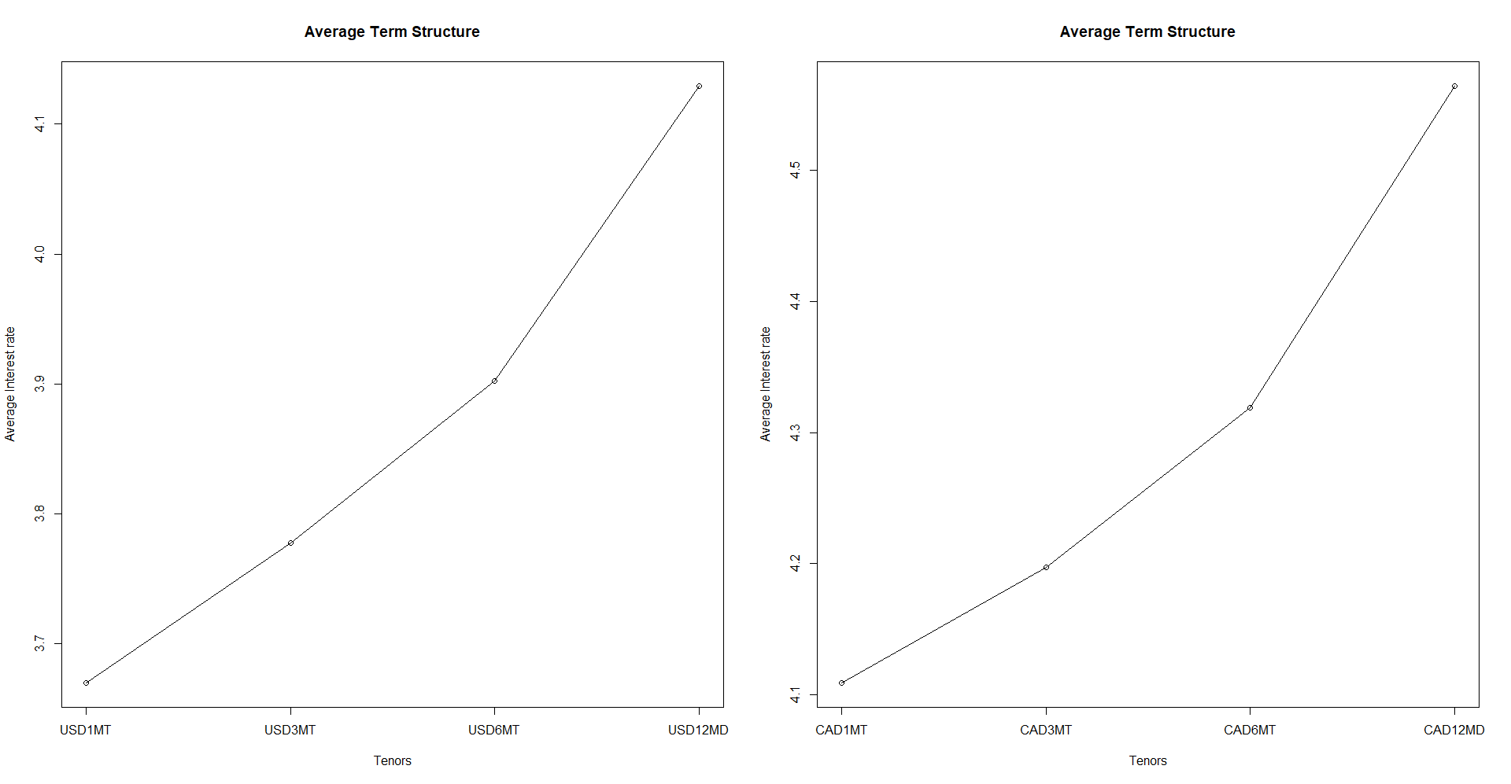
AVERAGE TERM STRUCTURE
The average term structure shows a general upward movement signifying investor confidence in the markets. An inverted term structure is usually an indication of a recession

Slide 18
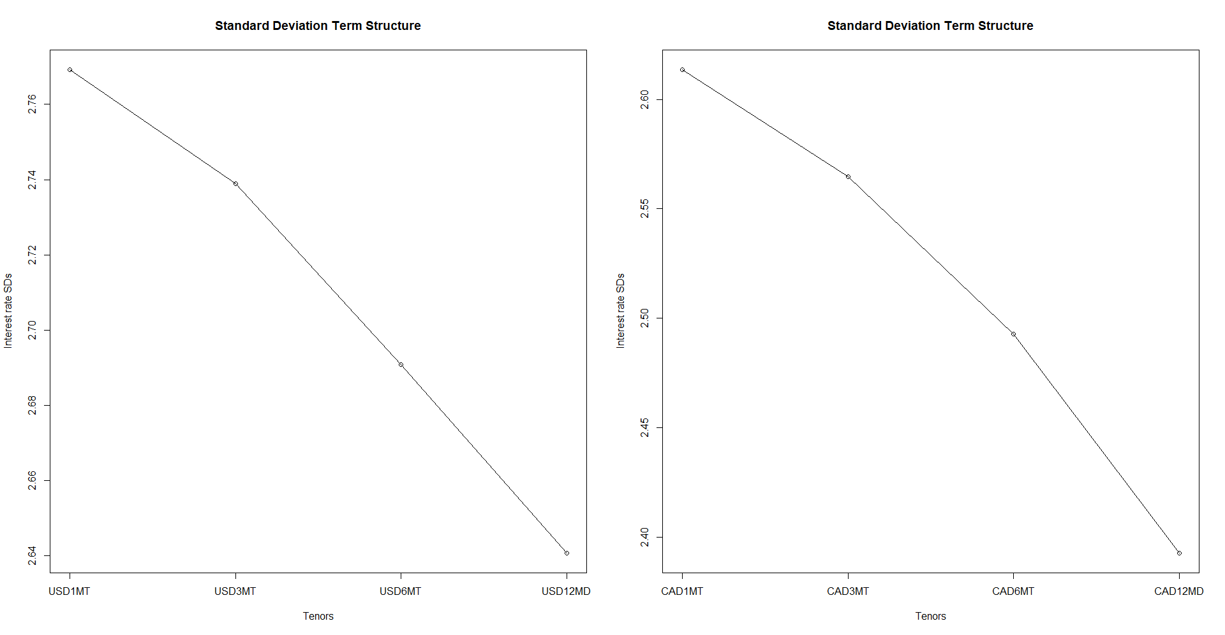
STANDARD DEVIATION
The standard deviation drops with increasing maturity.

Slide 19
PRINCIPAL COMPONENT ANALYSIS
 | USD 1-day | USD 30-day | CAD 1-Day | CAD 30-Day
First PC | 74.76% | 88.38% | 83.38% | 90.64%
Second PC | 18.98% | 9.68% | 12.43% | 8.47%
Third PC | 4.29% | 1.66% | 2.63% | 0.69%
Cumulative Variance | 98.03% | 99.72% | 98.44% | 99.80%

Slide 20
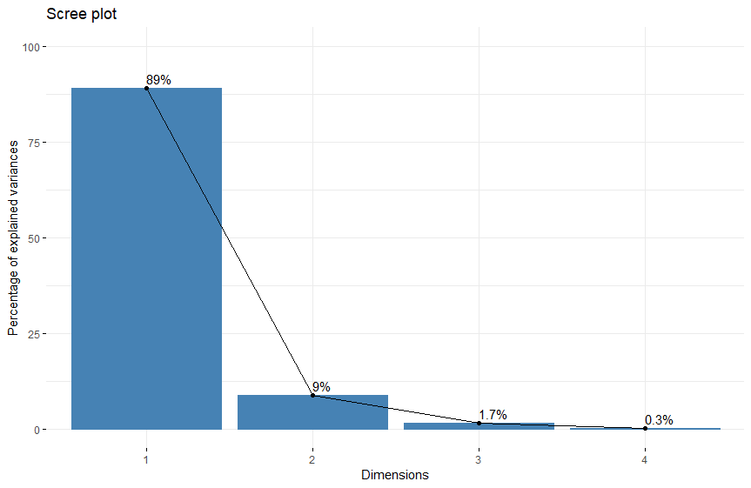
PRINCIPAL COMPONENT ANALYSIS

Slide 21
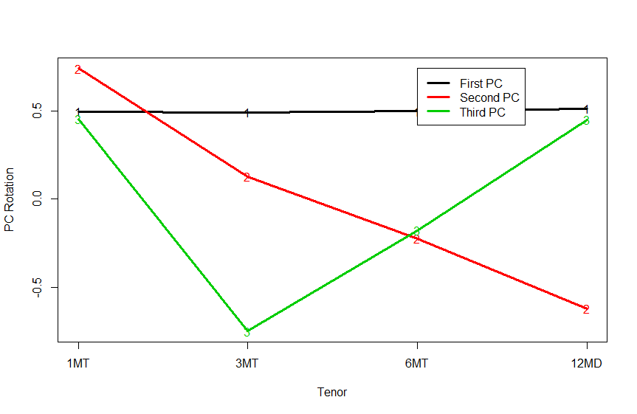
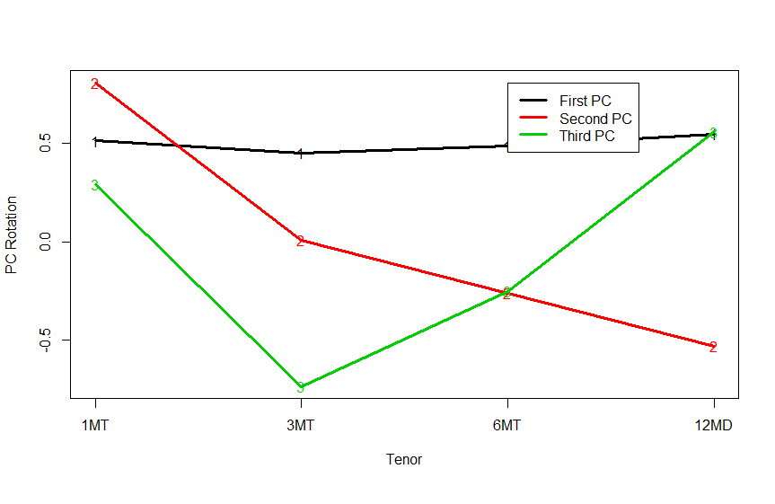
PRINCIPAL COMPONENT ANALYSIS
USD 30-day increment
USD 1-day increment
The first three principal components represent the shift (levels), twist(slope) and butterfly(curvature).

Slide 22
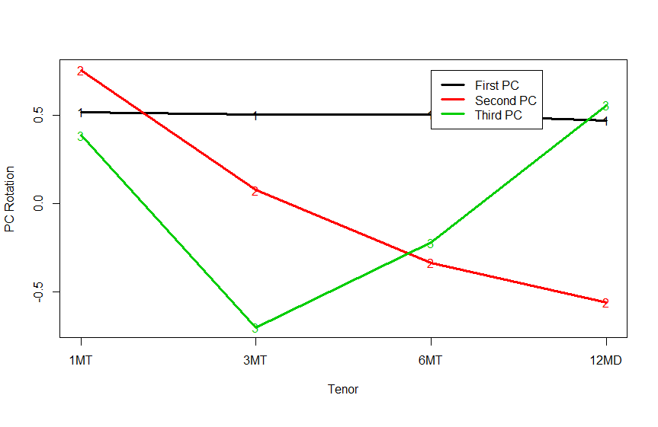
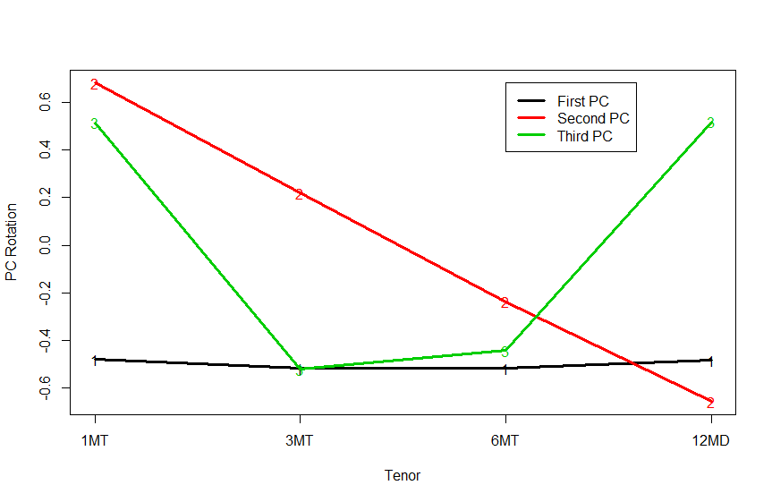
PRINCIPAL COMPONENT ANALYSIS
CAD 30-day increment
CAD 1-day increment

Slide 23
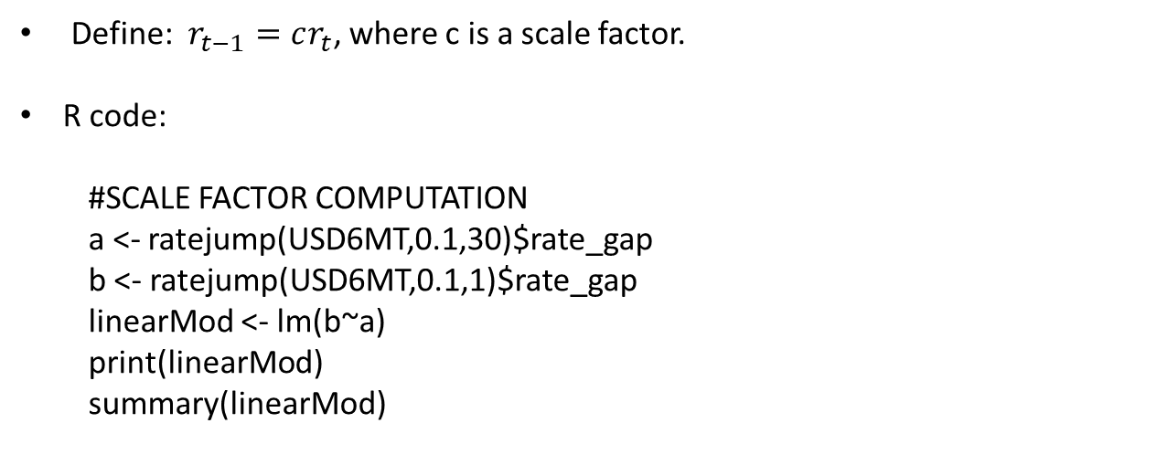
SCALE FACTOR
Define: $r_{t−1}=cr_{t}$, where c is a scale factor.
R code:
#SCALE FACTOR COMPUTATION
a <- ratejump(USD6MT,0.1,30)$rate_gap
b <- ratejump(USD6MT,0.1,1)$rate_gap
linearMod <- lm(b~a)
print(linearMod)
summary(linearMod)

Slide 24
VASICEK MODELLING
Vasicek SDE: $dr_{t}=κ\left(θ−r_{t}\right)dt+ σdW_{t}$
mod1 = setModel(drift = "kappa*(mu-r)", diffusion = "sigma",state.variable = "r", time.variable = "t", solve.variable = "r" )
data = setYuima(model = mod1, data = setData(USD1MT$rate))
initials = list(mu =2.5, sigma=3,kappa = 1 )
lwb = list(mu = 0, sigma = 0,kappa =0)
upb = list(mu = 5, sigma = 5,kappa =1)
mle = qmle(data, start = initials, lower =lwb, upper =upb)
summary(mle)
prior <- list(mu =list(measure.type="code",df= "dgamma(z,0,5)"),
sigma=list(measure.type="code",df= "dgamma(z,0,5)"),
kappa = list(measure.type="code",df= "dgamma(z,0,1)"))
bayes <- adaBayes(data, start = initials, prior = prior,lower =lwb, upper =upb)

